Slide 1
CSE 445 Lecture 8.2
Linear classifier by decision boundary (2)

Slide 2
Multiclass Classification
Binary classifiers such as logistic regression, perceptron, and SVM do not natively handle multi-class problems, so they rely on meta-strategies to extend them.
In the One-vs-Rest (OvR) strategy, a separate binary classifier is trained for each class, distinguishing that class from all remaining classes.
In the One-vs-One (OvO) strategy, a binary classifier is trained for every pair of classes, so each model learns to discriminate between just two classes at a time.

Slide 3
One-vs-One (OvO) strategy
The One-vs-One (OvO) strategy constructs a separate binary classifier for every possible pair of classes.
Suitable when the number of classes is modest, because each model focuses on distinguishing between just two classes while ignoring the rest.
Training phase
For every pair of classes, train a binary SVM/perceptron/LR using only the data points from those two classes.
For example, with three classes A, B, and C, OvO trains three classifiers:
A vs B
A vs C
B vs C
Prediction phase
For a new instance, each binary classifier predicts one of its two classes and effectively casts a vote for that class.
All votes across classifiers are counted.
The class that receives the highest number of votes is chosen as the final prediction.

Slide 4
One-vs-Rest (OvR) strategy
The One-vs-All (OvA) approach, also called One-vs-Rest (OvR), trains one binary classifier per class. For each classifier, its target class is treated as the positive class, and all remaining classes are grouped together as the negative class. This method is conceptually simple and the number of classifiers grows linearly with the number of classes.
Training phase
For a dataset with n classes, train n binary classifiers.
For each class C_{i} , build a classifier that learns to distinguish C_{i} (positive) from "not C_{i}" (all other classes combined, negative).
Prediction phase
For a new instance, each classifier produces a score (or probability) indicating how likely it is to belong to its corresponding class.
The instance is assigned to the class whose classifier outputs the highest score.

Slide 5
Multiclass linear classification
How to make OvR work?
We will let each class has its linear boundaries

Slide 6
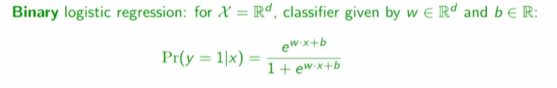

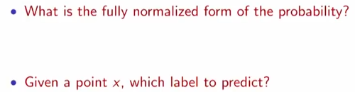
From binary to multiclass logistic regression

Slide 7
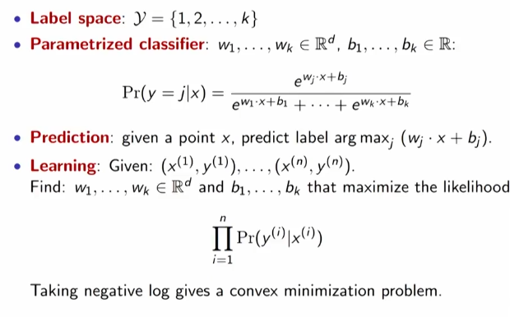
Multiclass logistic regression

Slide 8
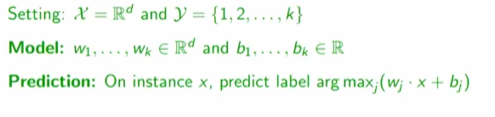
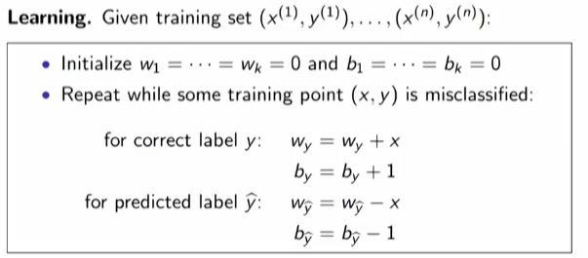
Multiclass Perceptron

Slide 9
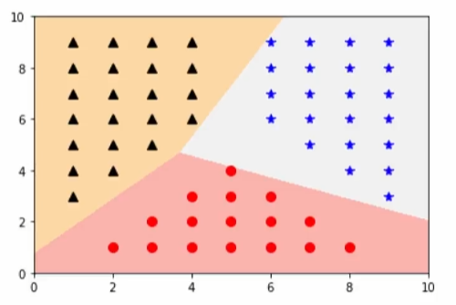
Multiclass perceptron example

Slide 10
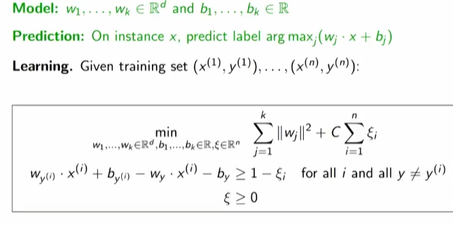
Multiclass SVM

Slide 11
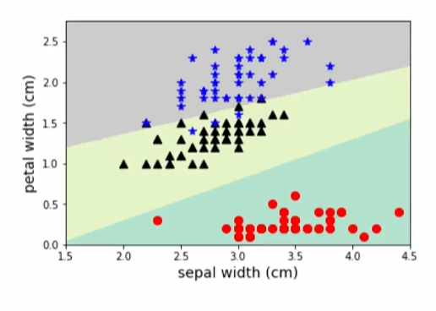
Multiclass SVM example: iris

Slide 12
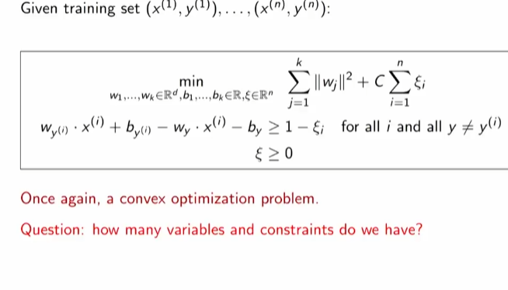
Multiclass SVM

Slide 13
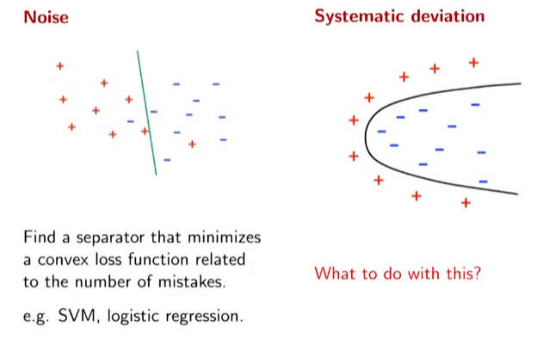
Kernel Methods
Two deviations from linear separability
Learning quadratic boundaries using basis expansion
What is Noise?

Slide 14
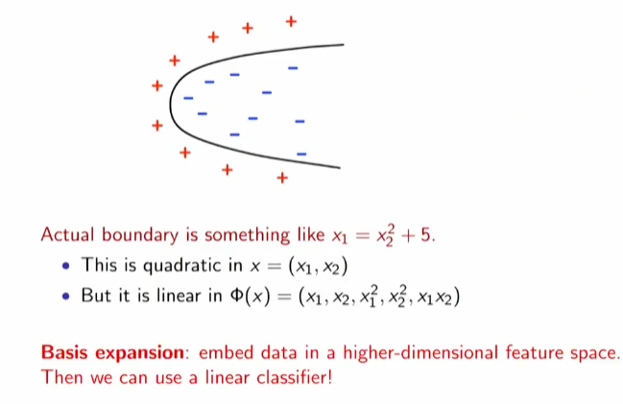
How do we deal with nonlinear boundaries?

Slide 15
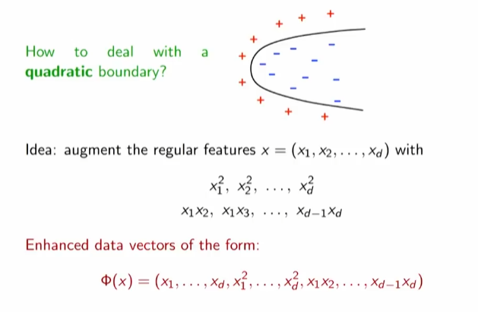
Basis expansion for quadratic boundaries

Slide 16
Idea check 1

Slide 17
Idea check 2

Slide 18
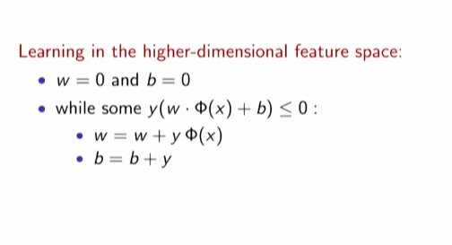
Perceptron for learning quadratic boundary

Slide 19
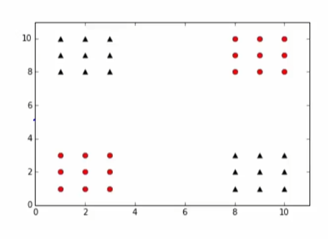
Perceptron with basis expansion: example 1

Slide 20
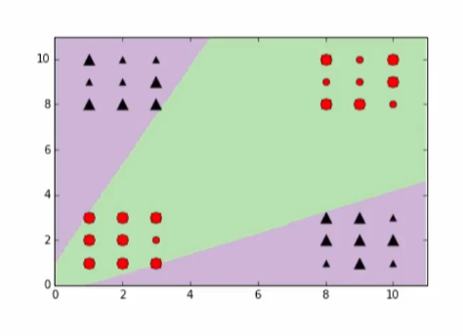
Perception with basis expansion
In 5D space the boundary is linear

Slide 21
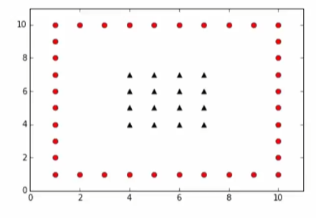
Perception with basis expansion: example 2

Slide 22
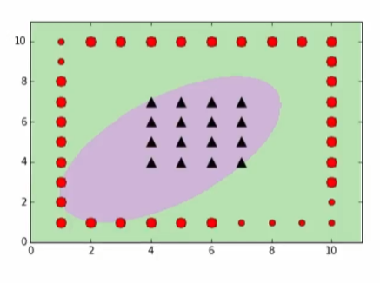
Perception with basis expansion
In 5D space the boundary is linear

Slide 23
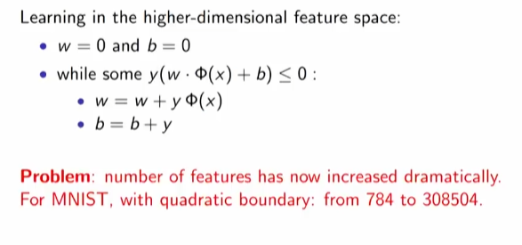

Perceptron with basis expansion: problem

Slide 24
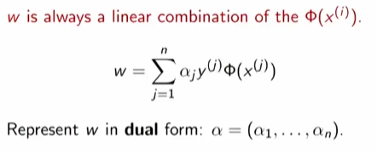
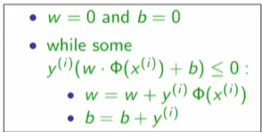
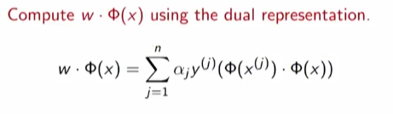

The kernel trick

Slide 25
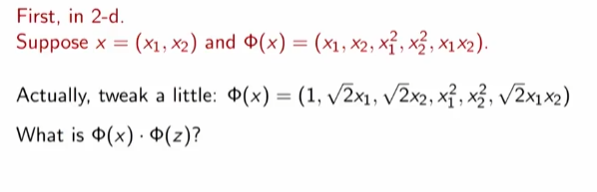
Computing dot products

Slide 26
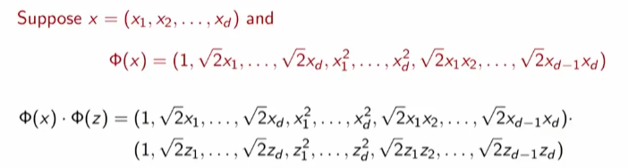
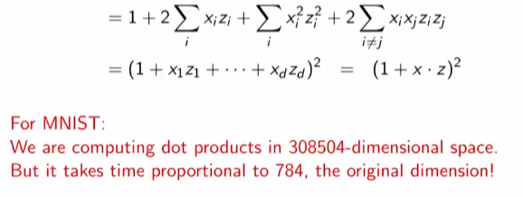
Computing dot products

Slide 27
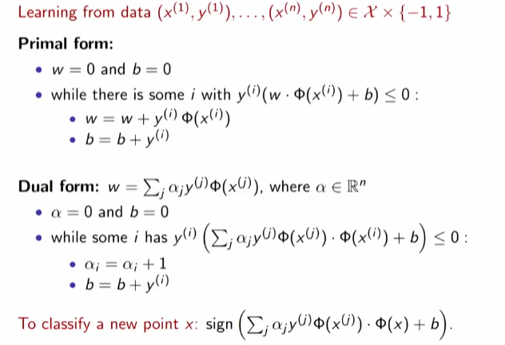
Kernel perceptron algorithm

Slide 28
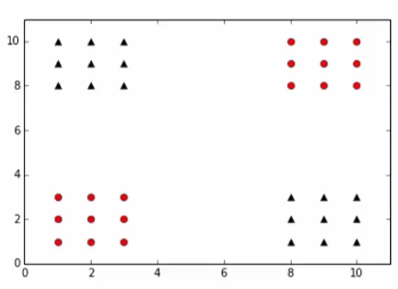
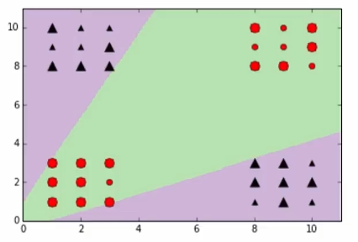
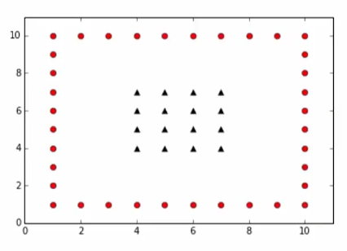
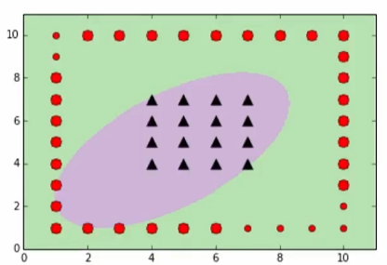
Using kernel trick of basis expansion

Slide 29
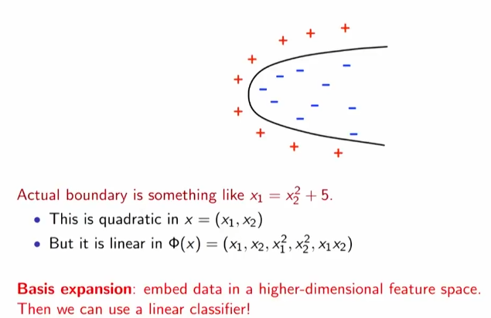
Expand the kernel trick to SVM
Kernel SVM
Polynomial decision boundaries
Basis expansion: replace input vector with expanded vectors
Function quadratic in X linear in phi (X)

Slide 30
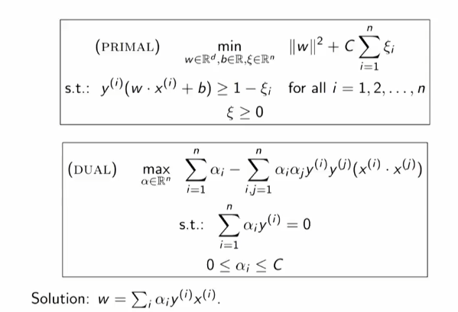
Support vector machine optimization

Slide 31
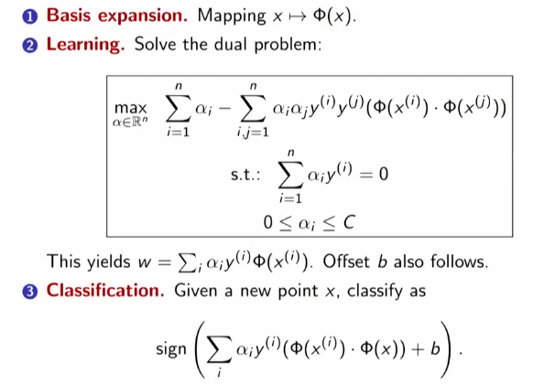
Kernel SVM

Slide 32
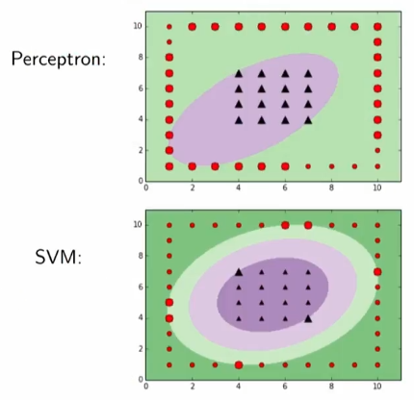
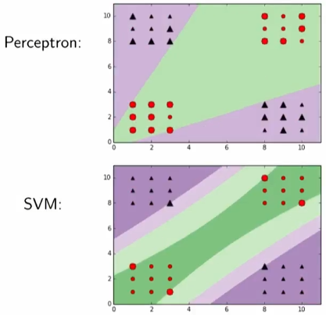
Kernel perceptron vs Kernel SVM

Slide 33
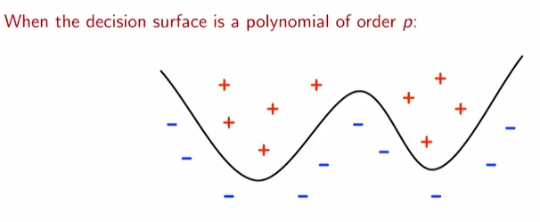
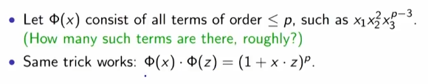
Polynomial decision boundaries

